Slide 1
Randomized Algorithms CS648
Lecture 23
Probabilistic Methods – final lecture
Derandomization – final lecture
Practice problems …

Slide 2
problem 4 Sum free subset of large size

Slide 3


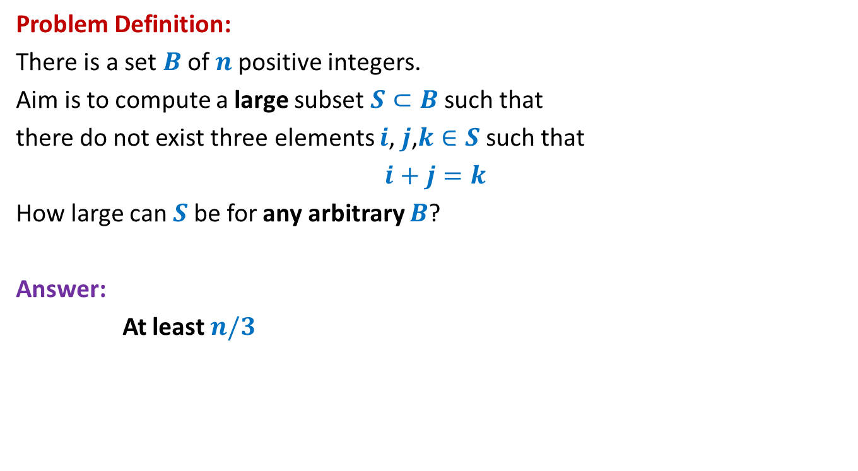



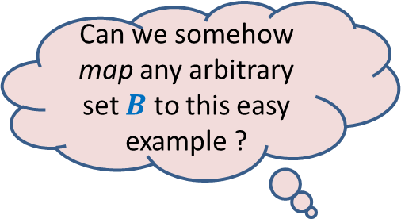
Large subset that is sum-free
Can we somehow map any arbitrary set $B$ to this easy example ?
Problem Definition:
There is a set $B$of $n$positive integers.
Aim is to compute a large subset $S⊂B$such that
there do not exist three elements $i$, $j$,$k∈S$ such that
$i+j=k$
How large can $S$be for any arbitrary $B$?
Answer:
At least $n/3$
Yes, by randomization
An easy example of $B$
Suppose $B=[1..n]$
$$n=3m$$
$m m+1$ … … $2m+1$
$1 2$ … … $3m$
$$S$$

Slide 4
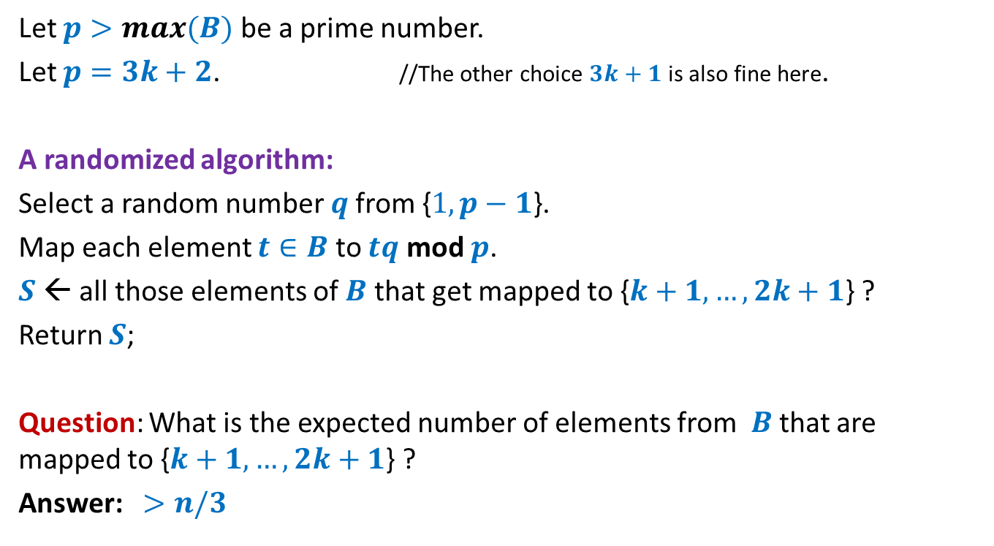
Large subset that is sum-free
Let $p>max(B)$ be a prime number.
Let $p=3k+2$. //The other choice $3k+1$ is also fine here.
A randomized algorithm:
Select a random number $q$from {$1,p−1$}.
Map each element $t∈B$ to $tq$ mod $p$.
$S$← all those elements of $B$ that get mapped to {$k+1,…,2k+1$} ?
Return $S$;
Question: What is the expected number of elements from $B$that are mapped to {$k+1,…,2k+1$} ?
Answer: $>n/3$
To prove it, use
the fact that mapping is 1-1 and uniform.
and Linearity of expectation.

Slide 5

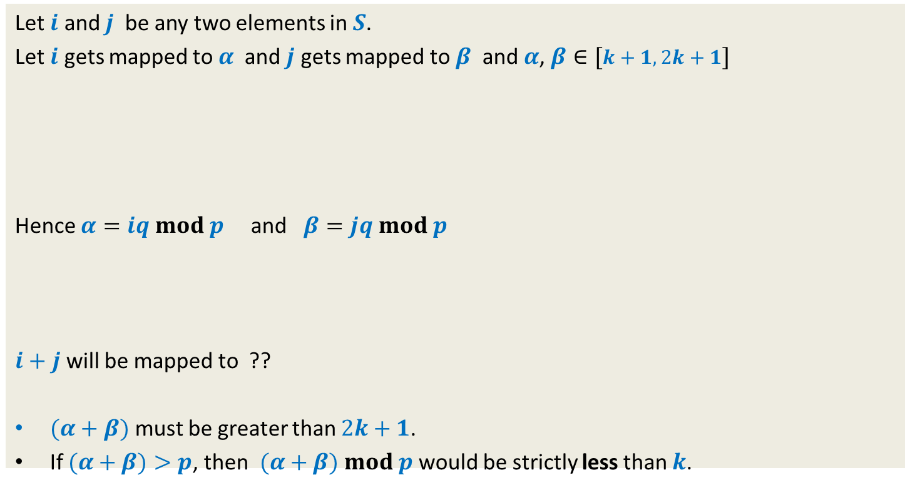


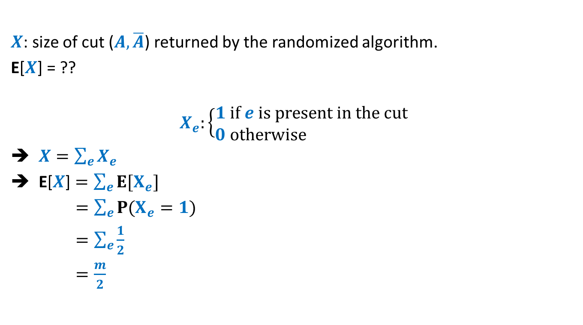





Showing that $S$is sum-free.
Let $i$ and $j$ be any two elements in $S$.
Let $i$ gets mapped to $α$ and $j$ gets mapped to $β$ and $α$, $β∈[k+1,2k+1]$
Hence $α=iq mod p$ and $β=jq mod p$
$i+j$ will be mapped to ??
$(α+β)$ must be greater than $2k+1$.
If $(α+β)>p$, then $(α+β)$ $mod p$ would be strictly less than $k$.
1 2 … $k$ $k+1$ … … … $2k+1$ … $3k+1$
$$α$$
$$β$$
$(α+β)$ $mod p$
$$\left(iqmod p+jqmod p\right)$$
$mod p$
$\left(i+j\right)q$ $mod p$
$\left(iq+jq\right)$ $mod p$
Because even for the largest two elements - $2k$ , $2k+1$ in the middle half,
their sum mod $p$ is $k−1$

Slide 6
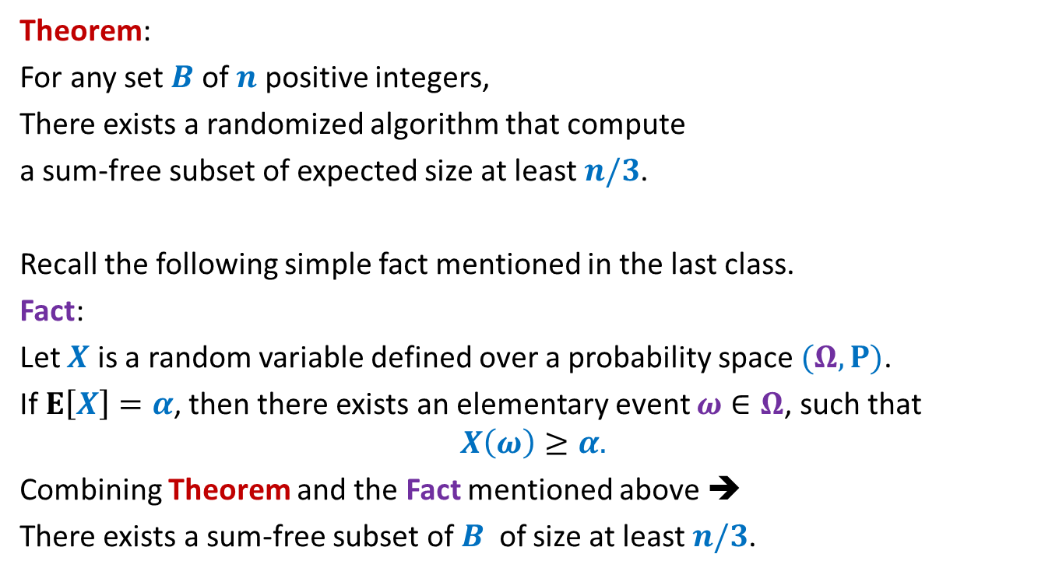
Large subset that is sum-free
Theorem:
For any set $B$ of $n$ positive integers,
There exists a randomized algorithm that compute
a sum-free subset of expected size at least $n/3$.
Recall the following simple fact mentioned in the last class.
Fact:
Let $X$ is a random variable defined over a probability space $(Ω,P)$.
If $E\left[X\right]=α$, then there exists an elementary event $ω∈Ω$, such that
$$X\left(ω\right)≥α.$$
Combining Theorem and the Fact mentioned above ➔
There exists a sum-free subset of $B$ of size at least $n/3$.

Slide 7
derandomization
a randomized algorithm ➔ a deterministic algorithm

Slide 8


derandomization
Method 1
Reduced sample space
by using pairwise independent random numbers
Theroem:
There is an O($mn$) time deterministic algorithm
that computes a cut of size at least $m/2$
in a graph having $m$ edges and $n$ vertices.
Method 2
Conditional expectation
O($m$)

Slide 9
Derandomization
using conditional expectation

Slide 10


Large cut in a graph
A randomized algorithm:
$A$←∅; $B$←∅;
For each vertex $v∈V$
Add $v$ to $A$or $B$ randomly independently with probability $\frac{1}{2}$
return the cut defined by $(A,B)$.
$$v_{1} v_{2} v_{3} … { v}_{i} v_{i+1} v_{n}$$

Slide 11

Notations:
For a given graph $G=(V,E)$, $U,W⊆V$ and $v∈V$,
$E(v)$:
set of all edges from $E$ that have $v$ as one of the endpoint.
$E(U)$:
set of all edges from $E$ that have at least one end point in $U$.
$E(U,W)$:
set of all edges from $E$ with one endpoint in $U$ and another in $W$.
$$E(U,W)\text{=}E∩(U⨯W)$$
$E(v,U)$:
set of all edges from $E$ with one endpoint $v$and another endpoint in $U$.
$$E(v,U)\text{=}E∩(v⨯U)$$

Slide 12


Notations:
$Z$ : random variable denoting the number of edges in a cut output by the algorithm.
$x_{i}$: random variable taking value 1 if $v_{i}∈A$ and 0 otherwise
$X_{i}$: {$x_{1}$, $x_{2}$, …, $x_{i}$}
$C_{i}$: {$c_{1}$, $c_{2}$, …, $c_{i}$} where $c_{j}∈\{0,1\}$ for $1≤j≤i$.
$X_{i}=C_{i}$ means
“$x_{1}=c_{1}\text{,}…,$ ${x_{i}=c}_{i}$”

Slide 13
conditional expectation
Make sure you understand “Conditional expectation” before using it.
So try to focus on the following slide.

Slide 14




$E\left[Z | X_{i}=C_{i}\right]=?$
$$V_{i}$$
$$v_{1} v_{2} v_{3} … { v}_{i} v_{i+1} v_{n}$$
$$A$$
$$B$$

Slide 15






$E\left[Z | X_{i}=C_{i}\right]=?$
$$V_{i}$$
|$E(V_{i}^{A},V_{i}^{B})$| +
$\text{|}E({V\backslash V}_{i})$|$/2$
$$v_{1} v_{2} v_{3} … { v}_{i} v_{i+1} v_{n}$$
$$V_{i}^{A}$$
$$V_{i}^{B}$$
…
…
$$A$$
$$B$$

Slide 16
Derandomization using conditional expectation

Slide 17










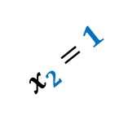

The Binary tree associated with the Randomized algorithm
$$E\left[Z\right]$$
$$x_{1}=1$$
$$x_{1}=0$$
$$E\left[Z | x_{1}=1\right]$$
$$E\left[Z | x_{1}=0\right]$$
$$x_{2}=1$$
$$x_{2}=0$$
$$x_{2}=1$$
$$x_{2}=0$$
$$E\left[Z | x_{2}=1,x_{1}=1\right]$$
$$n$$
…
A cut of value $≥m/2$

Slide 18

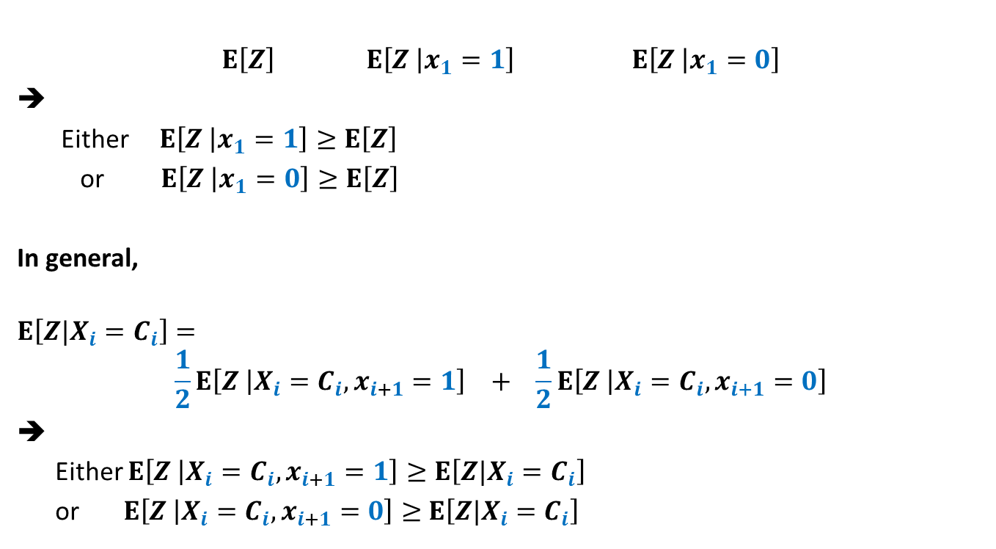
Role of conditional expectation
$$E\left[Z\right] E\left[Z | x_{1}=1\right] E\left[Z | x_{1}=0\right]$$
Either $E\left[Z | x_{1}=1\right]≥E\left[Z\right]$
or $E\left[Z | x_{1}=0\right]≥E\left[Z\right]$
In general,
$$E\left[Z|X_{i}=C_{i}\right]=$$
$$\frac{1}{2}E\left[Z | X_{i}=C_{i}, x_{i+1}=1\right] + \frac{1}{2}E\left[Z | X_{i}=C_{i}, x_{i+1}=0\right]$$
➔
Either $E\left[Z | X_{i}=C_{i}, x_{i+1}=1\right]≥E\left[Z|X_{i}=C_{i}\right]$
or $E\left[Z | X_{i}=C_{i}, x_{i+1}=0\right]≥$ $E\left[Z|X_{i}=C_{i}\right]$
= $\frac{1}{2}$ + $\frac{1}{2}$

Slide 19

Using Conditional expectation
$$\frac{m}{2}=E\left[Z\right]$$
We wish to make choices for $x_{j}$’s such that
$E\left[Z\right] ≤E\left[Z | x_{1}=c_{1}\right]$
$$≤E\left[Z | x_{2}=c_{2},x_{1}=c_{1}\right]$$
$≤E\left[Z|X_{n}=C_{n}\right]$
IDEA:
Given that $E\left[Z|X_{i}=C_{i}\right]$ $≥\frac{m}{2}$, choose that value for $x_{i+1}$ such that
$$E\left[Z|X_{i+1}=C_{i+1}\right]≥E\left[Z|X_{i}=C_{i}\right]$$
…

Slide 20
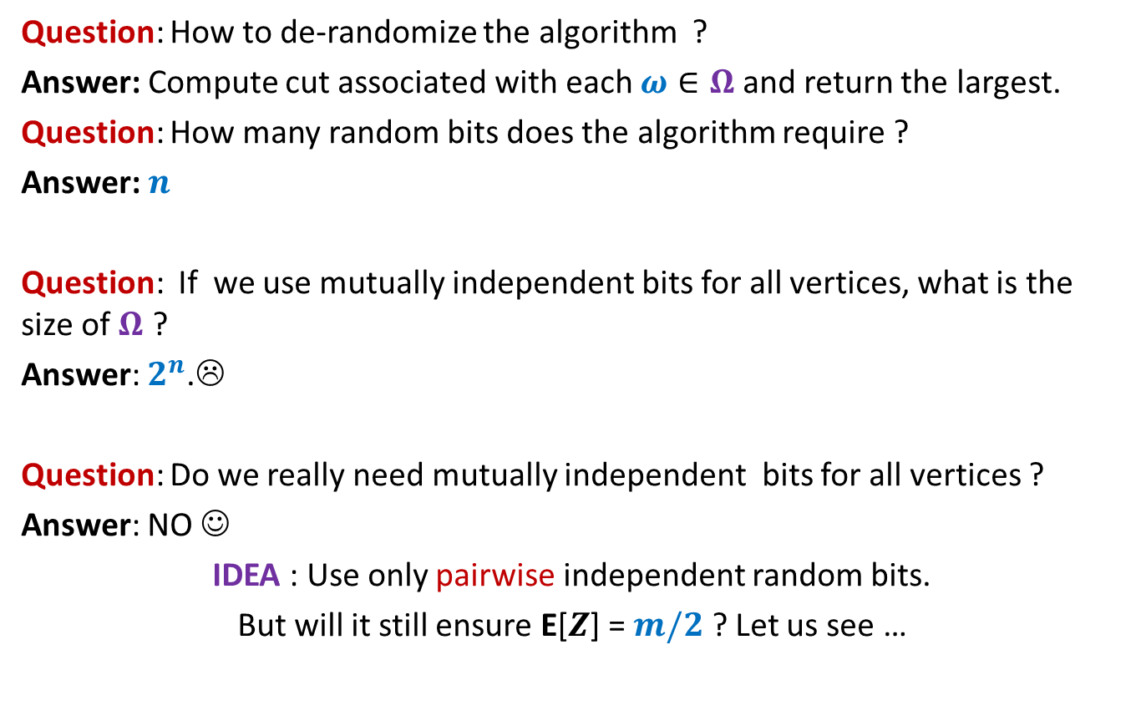
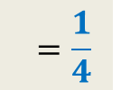

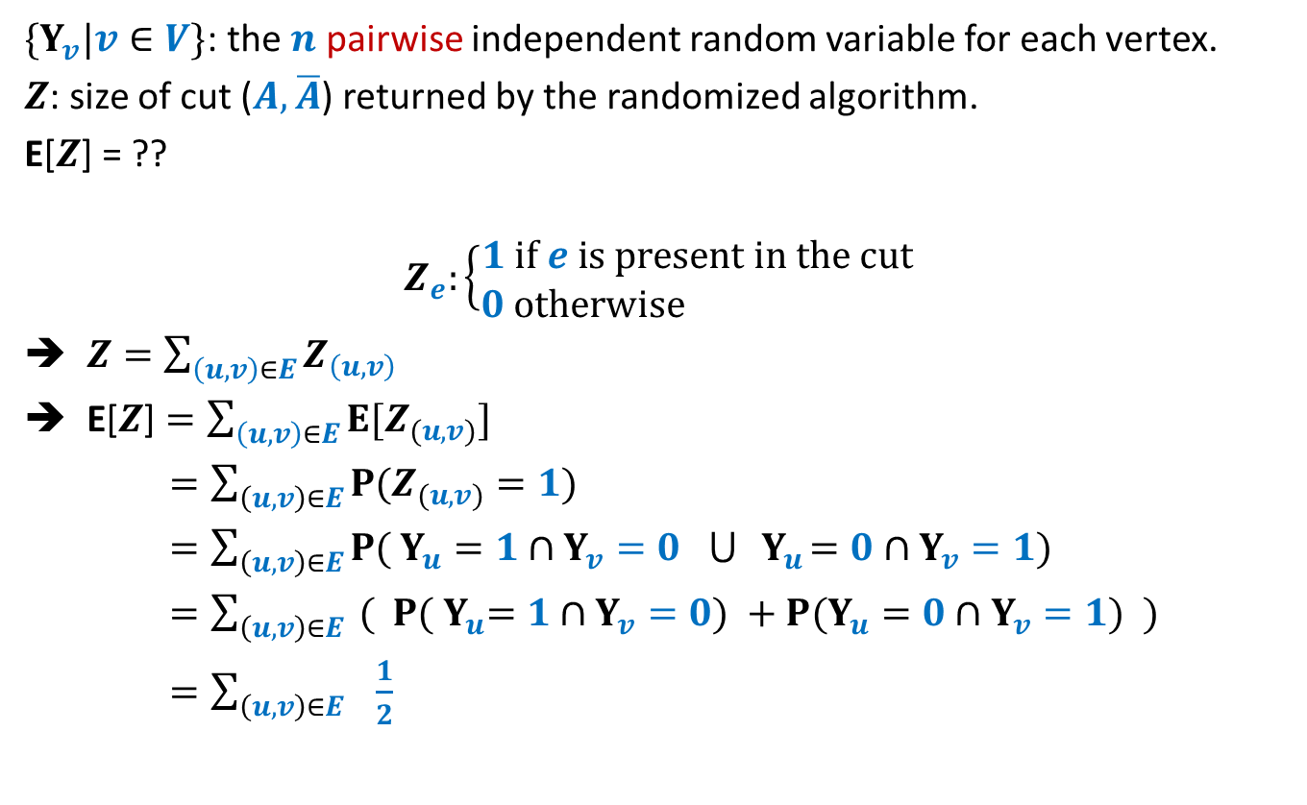
$E\left[Z | X_{i}=C_{i}\right]≥\frac{m}{2}$
$E\left[Z | X_{i}=C_{i}\right]$= |$E(V_{i}^{A},V_{i}^{B})$| + $\text{|}E({V\backslash V}_{i})$|$/2$
$$E\left[Z | X_{i}=C_{i}\right]=\frac{1}{2}E\left[Z | X_{i}=C_{i},x_{i+1}=1\right] + \frac{1}{2}E\left[Z | X_{i}=C_{i},x_{i+1 }=0\right]$$
$E\left[Z | X_{i}=C_{i},x_{i+1}=1\right]$= ??
$E\left[Z | X_{i}=C_{i},x_{i+1}=0\right]$= ??
Question: Should we assign $v_{i+1}$ to $A$ or to $B$ ?
➔ Assign $v_{i+1}$ to $A$ if |$E(v_{i+1},V_{i}^{B})$|$≥$ |$E(v_{i+1},V_{i}^{A})$|
|$E(V_{i}^{A},V_{i}^{B})$| + |$E(v_{i+1},V_{i}^{B})$| + $\text{|}E({V\backslash V}_{i+1})$|$/2$
|$E(V_{i}^{A},V_{i}^{B})$| + |$E(v_{i+1},V_{i}^{A})$| + $\text{|}E({V\backslash V}_{i+1})$|$/2$

Slide 21

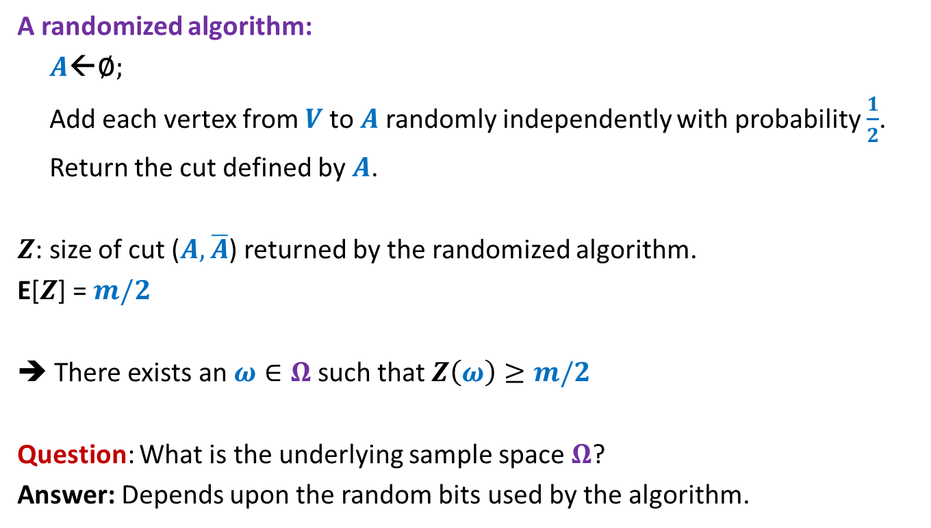


Making Choice for $v_{i+1}$
$$V_{i}$$
$$v_{1} v_{2} v_{3} … { v}_{i} v_{i+1} v_{n}$$
$$V_{i}^{A}$$
$$V_{i}^{B}$$
…
…
$$v_{i+1}$$
$$v_{i+1}$$
$$A$$
$$B$$

Slide 22

Deterministic algorithm for Large cut
Input: $G$ = ($V,E$)
$A$←∅; $B$←∅;
For each vertex $v∈V$
{ if |$E(v,B)$|> |$E(v,A)$|
Add $v$ to $A$;
else
Add $v$ to $B$;
}
return the cut defined by $(A,B)$.
Time Complexity: O($m$).
Theorem: There is a deterministic O($m$) time algorithm to compute a cut of size at least $m/2$ in any given undirected graph.
This was a simple example of using conditional expectation to derandomize a randomized algorithm. But it conveys the crux of this powerful method. In order to use it to derandomize any other algorithm, all you might need is creative and analytical skills.
Also remember, we can not hope to derandomize every randomized algorithm. But if it is possible to derandomize an algorithm, conditional expectation may prove to be a very useful tool.

Slide 23
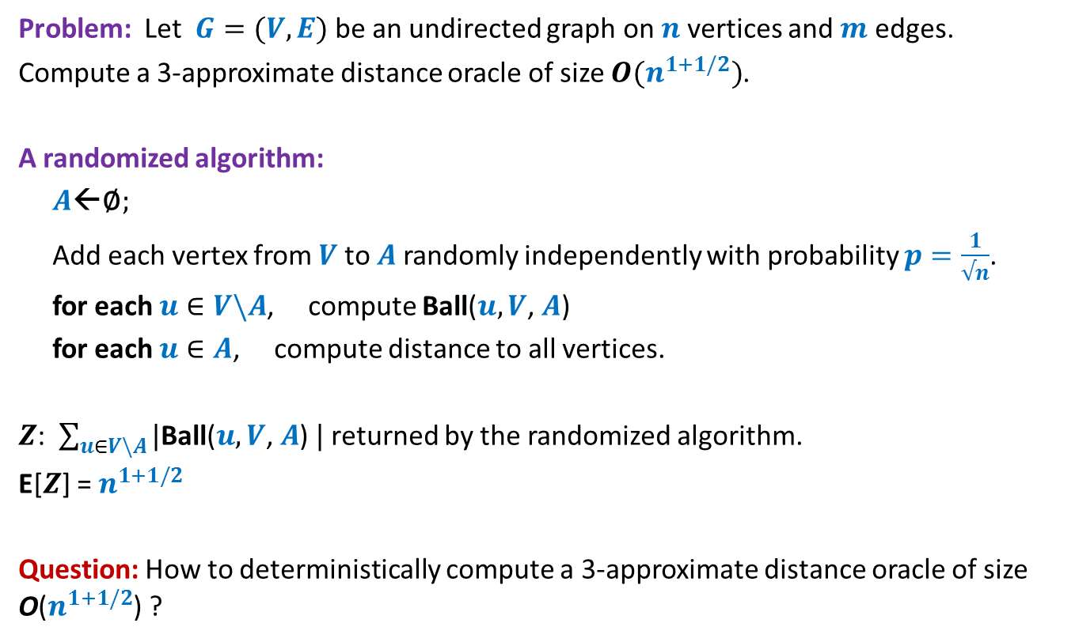
Problem 2: Approximate Distance Oracles
Problem: Let $G=(V,E)$ be an undirected graph on $n$vertices and $m$ edges.
Compute a 3-approximate distance oracle of size $O(n^{1+1/2})$.
A randomized algorithm:
$A$←∅;
Add each vertex from $V$to $A$randomly independently with probability $p=\frac{1}{√n}$.
for each $u∈V\backslash A$, compute Ball($u, V$, $A$)
for each $u∈A$, compute distance to all vertices.
$Z$: $\sum_{u∈V\backslash A}{|\text{Ball}\text{(}u, V\text{,} A\text{) }|}$ returned by the randomized algorithm.
E[$Z$] = $n^{1+1/2}$
Question: How to deterministically compute a 3-approximate distance oracle of size O($n^{1+1/2}$) ?
A non-trivial application of conditional expectation (published in ICALP 2005)

Slide 24
3 Practice Problems

Slide 25
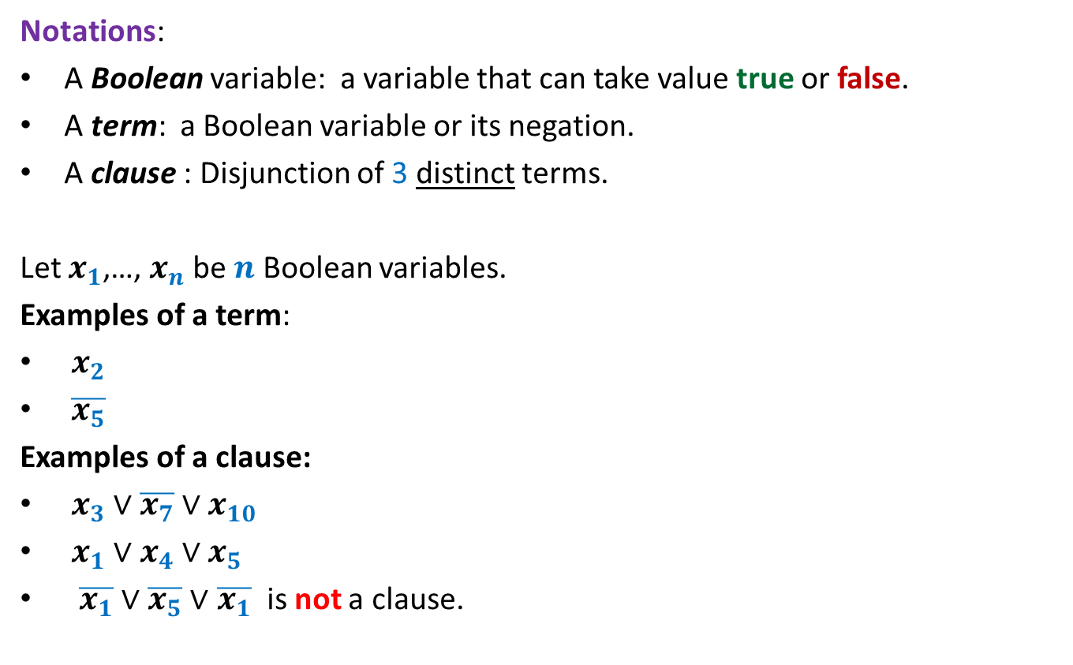
3-SAT Problem
Notations:
A Boolean variable: a variable that can take value true or false.
A term: a Boolean variable or its negation.
A clause : Disjunction of 3 distinct terms.
Let $x_{1}$,…, $x_{n}$ be $n$ Boolean variables.
Examples of a term:
$x_{2}$
$\overline{x_{5}}$
Examples of a clause:
$x_{3}∨\overline{x_{7}}∨x_{10}$
$x_{1}∨x_{4}∨x_{5}$
$\overline{x_{1}}∨$ $\overline{x_{5}}∨$ $\overline{x_{1}}$ is not a clause.

Slide 26
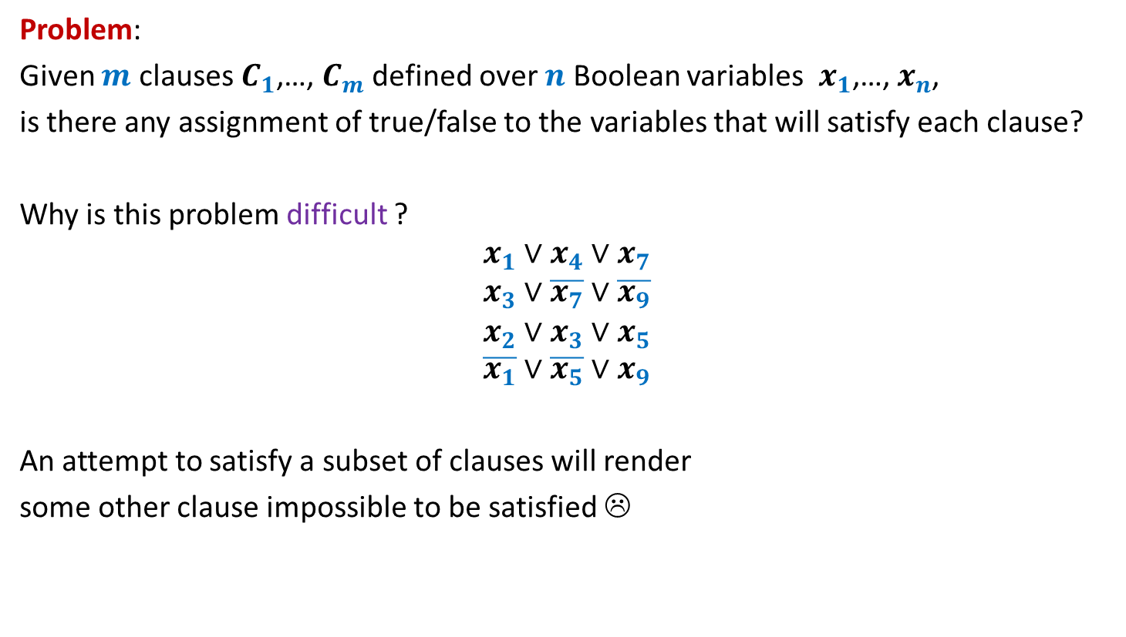
3-SAT Problem
Problem:
Given $m$ clauses $C_{1}$,…, $C_{m}$ defined over $n$ Boolean variables $x_{1}$,…, $x_{n}$,
is there any assignment of true/false to the variables that will satisfy each clause?
Why is this problem difficult ?
$$x_{1}∨x_{4}∨x_{7}$$
$$x_{3}∨\overline{x_{7}}∨\overline{x_{9}}$$
$$x_{2}∨x_{3}∨x_{5}$$
$$\overline{x_{1}}∨\overline{x_{5}}∨x_{9}$$
An attempt to satisfy a subset of clauses will render
some other clause impossible to be satisfied ☹

Slide 27
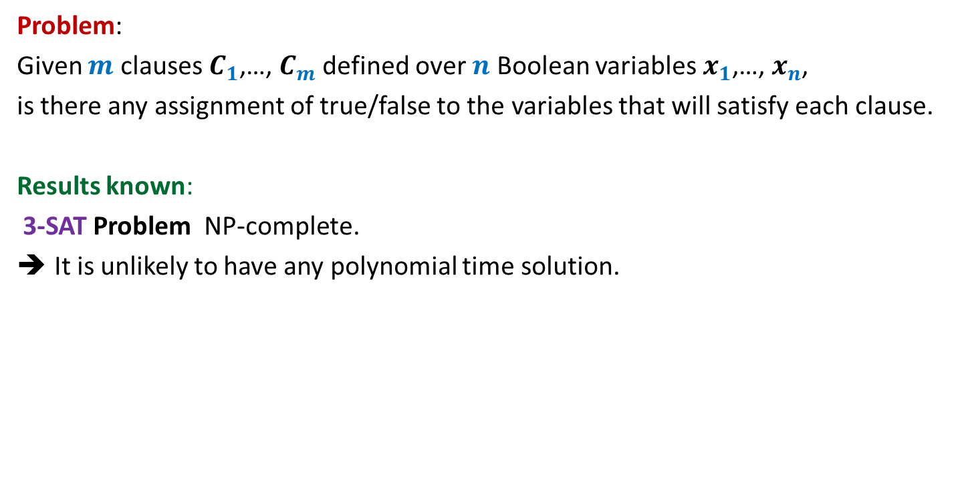
3-SAT Problem
Problem:
Given $m$ clauses $C_{1}$,…, $C_{m}$ defined over $n$ Boolean variables $x_{1}$,…, $x_{n}$,
is there any assignment of true/false to the variables that will satisfy each clause.
Results known:
3-SAT Problem NP-complete.
It is unlikely to have any polynomial time solution.

Slide 28
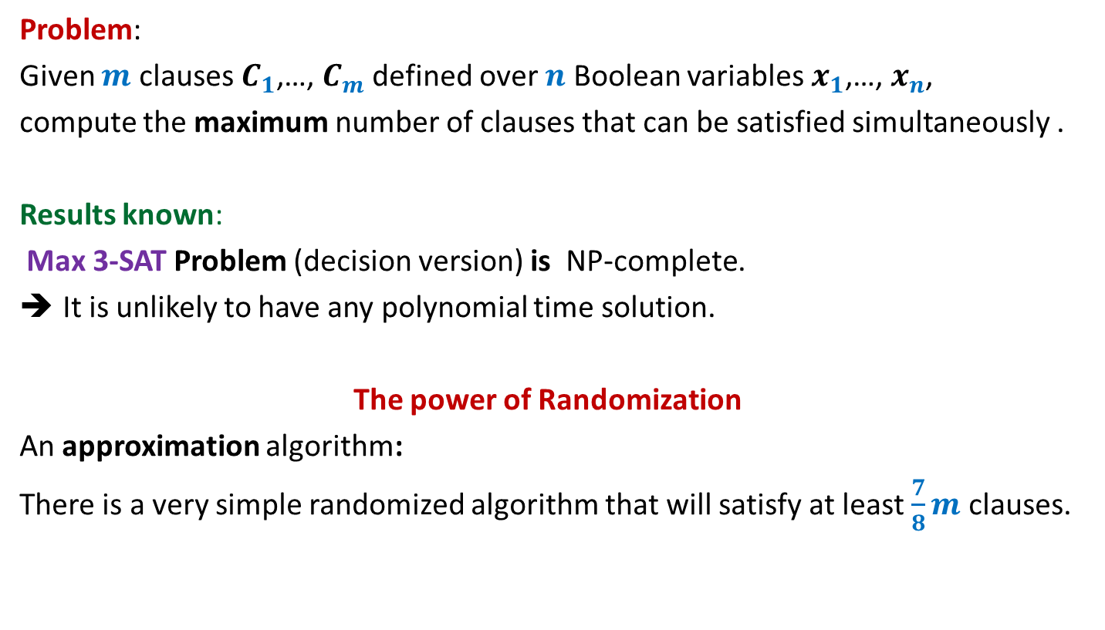
Max 3-SAT Problem
Problem:
Given $m$ clauses $C_{1}$,…, $C_{m}$ defined over $n$ Boolean variables $x_{1}$,…, $x_{n}$,
compute the maximum number of clauses that can be satisfied simultaneously .
Results known:
Max 3-SAT Problem (decision version) is NP-complete.
It is unlikely to have any polynomial time solution.
The power of Randomization
An approximation algorithm:
There is a very simple randomized algorithm that will satisfy at least $\frac{7}{8}m$ clauses.

Slide 29

Restoring distance matrix
$G$is an undirected unweighted graph.
$D$ is a matrix storing all-pairs distances of $G$.
Unfortunately, all entries with value larger than $\frac{n}{10}$ are corrupted.
Aim: Monte-Carlo algorithm with running time $O(n^{2} log n)$.

Slide 30

Ham-sandwich cut
¼-approximate
Trivial algorithm : $O(n^{3})$ time
Best deterministic algorithm: $O(n)$ time

